Slide 1

Alta Wireless High Temperature Sensors (Industrial)

Slide 2
Introduction
The ALTA Wireless High Temperature Sensor uses a glass coated platinum RTD sensor to accurately measure temperatures from -50°C to +370°C (-58°F to 700°F).
Standard accuracy at 0°C: +/- 3.3°C
Calibrated accuracy at 0°C: +/- 0.5°C
RTD temperature range: -50°C to +370°C (-58°F to 700°F)

Slide 3
Principle of Operation
The ALTA Wireless High Temperature Sensor outputs the ambient temperature in degrees Celsius or Fahrenheit.
It is programmed to sleep for a user-given time interval (heartbeat) and then wakeup, power up the RTD sensor and wait for it to stabilize then mathematically compute the temperature and transmit the data to the gateway.

Slide 4
Example Applications
Heaters & Boilers
Ovens & Cooking Devices
Environmental Monitoring
Smart Machines & Smart Structures
HVAC Operation & Testing

Slide 5
Features
Wireless range of 1,000+ feet through 12-14 walls
Frequency Hopping Spread Spectrum (FHSS)
Improved interference immunity
Improved power management for longer battery life ** (10+ years on AA batteries)
Encrypt-RF™ Security (Diffie-Hellman Key Exchange + AES-128 CBC for sensor data messages)
Onboard data memory / storage (up to 512 readings per sensor) - 10 min heartbeats = 3.5 days - 2 hour heartbeats = 42 days
Over-the-air updates (future proof)
Free iMonnit basic online wireless sensor monitoring and notification system to configure sensors, view data and set alerts via SMS text and email.

Slide 6
Order of Operations
Create iMonnit Account (If new user).
Register all sensors and gateways to a network in iMonnit. Sensors can only communicate with gateways on the same iMonnit network.
Connect/power on gateway and wait till it checks into iMonnit.
Power on sensor and verify it checks into iMonnit. We recommend powering the sensor on near the gateway then moving to the installation location, checking signal strength along the way.
Configure sensor for use (This can be done at any point after step 2).
Install sensor in final location.

Slide 7
Setup and Installation
Step 1:
Add the sensor on iMonnit. Add the sensor to your account by choosing Sensors in the main menu. Navigate to the Add Sensor button.
. Find the device ID. The Device ID (ID) and Security Code (SC) are necessary to add a sensor. These can both be located on the label on the side of your device.
Adding your device. You will need to enter the Device ID and the Security Code from your Sensor in the corresponding text boxes. Use the camera on your smartphone to scan the QR code on your device.
If you do not have a camera on your phone, or the system is not accepting the QR code, you may enter the Device ID and Security Code manually.
The Device ID is a unique number located on each device label. Next, you’ll be asked to enter the Security Code from your device. A security code consists of letters and must be entered in upper case (no numbers). It can also be found on the barcode label of your device.
When completed, select the Add Device button.

Slide 8
Setup and Installation
Step 2: Setup
Select your use case. Choose from the list or create your own custom settings. You will see the heartbeat interval, and aware state settings. Select the Skip button when completed.
Step 3: Validation
Check your signal. The validation checklist will help you ensure your sensor is communicating with the gateway properly and you have a strong signal.
Step 4: Actions
Choose your actions. Actions are the alerts that will be sent to your phone or email in the event of an emergency.
Industrial sensors need a 3.6V Lithium battery supplied from iMonnit or another industrial battery supplier.

Slide 9
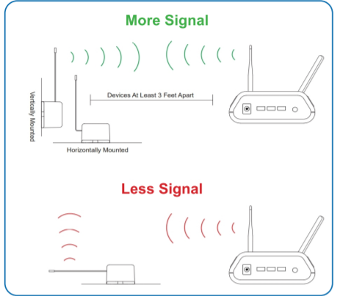
Antenna Orientation
In order to get the best performance out of your ALTA Wireless Sensors, it is important to note proper antenna orientation and sensor positioning.
Antennas should all be oriented in the same direction, pointing vertically from the sensor.
If the sensor is mounted flat on its back on a horizontal surface, you should bend the antenna as close to the sensor housing as possible giving you the most amount of antenna pointing vertical.
You should make the antenna wire as straight as possible, avoiding any kinks and curving of the wire.
Sensors must be at least 3 ft. away from other sensors and the wireless gateway to function.

Slide 10

Sensor Overview In iMONNIT
Select Sensors from the main navigation menu on iMonnit to access the sensor overview page and begin making adjustments to your Advanced Vibration Meter.
A. Details - Displays a graph of recent sensor data.
B. History - List of all past heartbeats and readings.
C. Events - List of all events attached to this sensor.
D. Settings - Editable levels for your sensor.
E. Scale - Set the scale your sensor will take readings at
Directly under the tab bar is an overview of your sensor. This allows you to see the signal strength and the battery level of the selected sensor. A coloured dot in the left corner of the sensor icon denotes its status.
Green indicates the sensor is checking in and within user-defined safe parameters.
Red indicates the sensor has met or exceeded a user-defined threshold or triggered event.
Grey indicates that no sensor readings are being recorded, rendering the sensor inactive.
Yellow indicates that the sensor reading is out of date, due to perhaps a missed heartbeat check-in.

